Slide 1
JHAs and More
Scott D. Cole, CSP, LEED GA
216.318.3878
sdcole@tcco.com

Slide 2
JHA, JSA, AHA, STA, PTP, etc…

Slide 3
Why is it Important?
One of the best ways to determine and establish proper work procedures is to conduct a job hazard analysis.
A job hazard analysis is one component of the larger commitment of a safety and health management system.

Slide 4
Why is it Important?
Every day workers are injured and killed in the workplace.
You can help prevent workplace injuries and illnesses by looking at your workplace operations, establishing proper job procedures, and ensuring that all employees are trained properly.

Slide 5
Washington Post January 18, 2017
One by one, 3 utility workers descended into a manhole. One by one, they died.
By Samantha Schmidt

Slide 6
The Regulations…
1910.132 – personal protective equipment
The employer shall assess the workplace to determine if hazards are present, or are likely to be present, which necessitate the use of personal protective equipment (PPE).
1910.146 – confined space
1910.147 – lockout / tagout

Slide 7
Job Hazard Analysis (JHA)
A JHA is a technique that focuses on job tasks as a way to identify hazards before they occur.
It focuses on the relationship between the worker, the task, the tools, and the work environment.

Slide 8
Hazard
Defined as a condition or activity that, if left uncontrolled, can result in an injury or an illness.
Simply put, it’s a potential for harm.

Slide 9
Prioritizing
Areas/equipment/tasks…
With the highest injury / illness rate
With the potential to cause severe or disabling injuries / illness
Which one simple human error may cause a severe injury
That are new or have gone through change in process or procedures

Slide 10
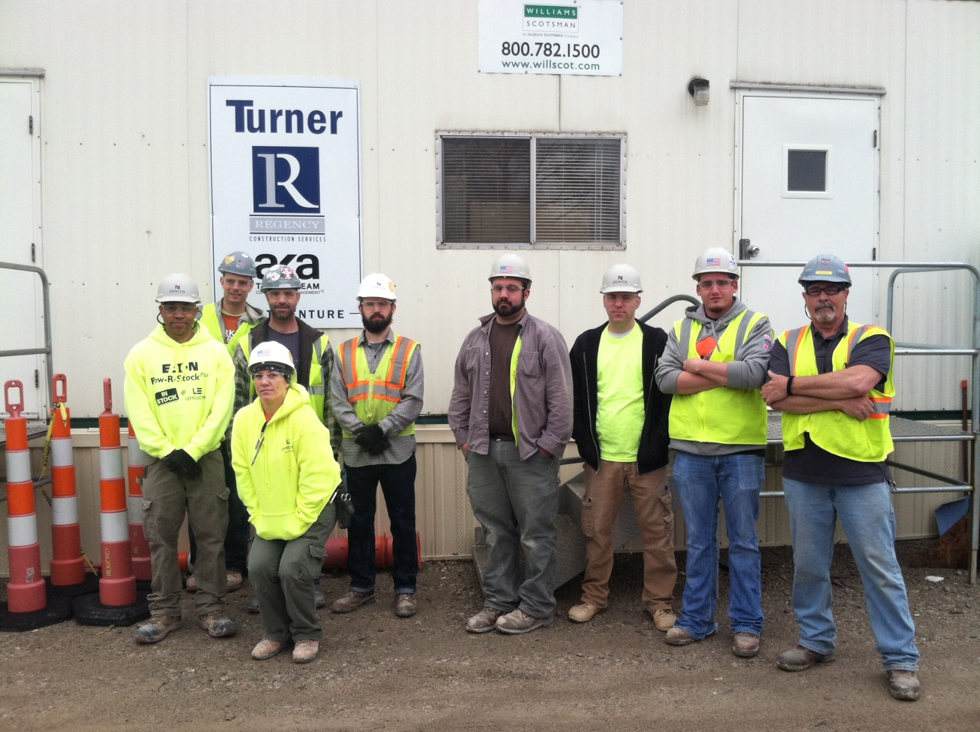
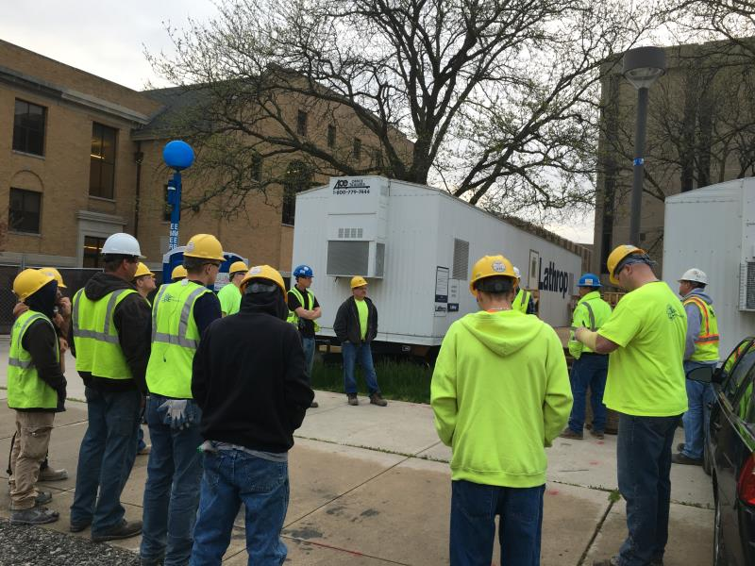
Worker Involvement

Slide 11
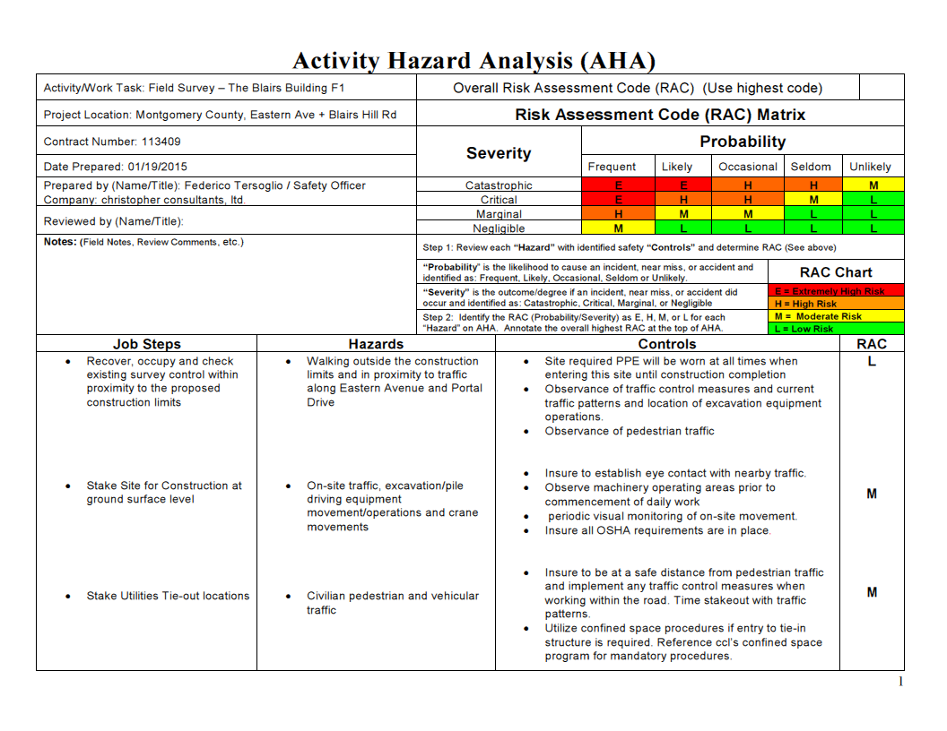

Slide 12
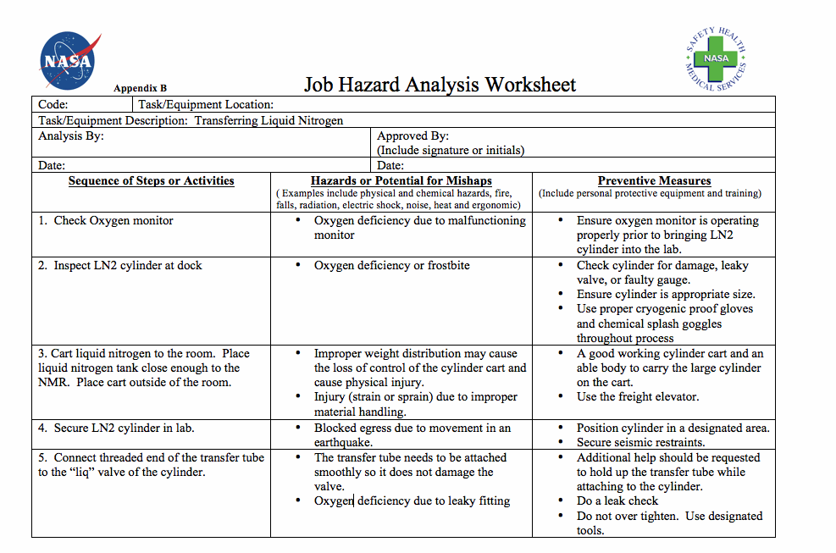

Slide 14
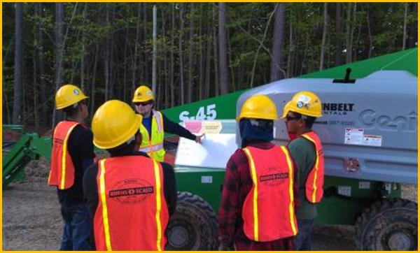

Slide 15
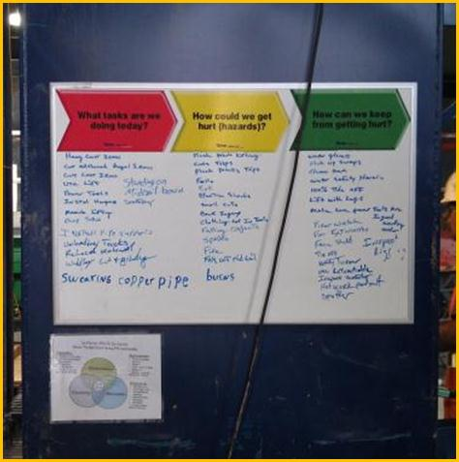

Slide 16
Q5 to Stay Alive
What can go wrong?
What are the consequences?
How could it happen?
What are the contributing factors?
How likely is it the hazard will occur?

Slide 17
Hierarchy of Controls
Engineering
Administrative
PPE

Slide 18
Should I Get Help?
If your employees are involved in many different or complex operations you should seek outside help
Remain involved in the process

Slide 19
Who Can Help?
Insurance company
Private safety consultant
BWC
OSHA

Slide 20
Thank You! Questions?

